Slide 1
Summary of Paper Reading
Steven Lai

Slide 2

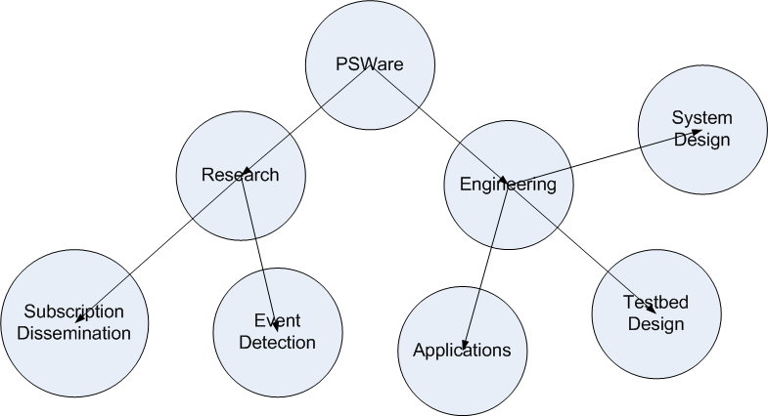
Topics Overview

Slide 3
Sensys 09
SigCom'08
  L. Mo, et al., “Canopy Closure Estimates with GreenOrbs: Sustainable Sensing in the Forest” (application)
  O. Gnawali, et al., "Collection Tree Protocol" (system design)

Slide 4
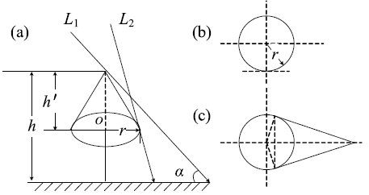
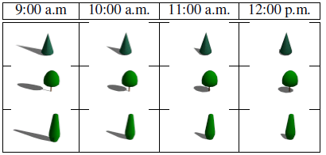
GreenOrbs
Key ideas
  Canopy closure: a method for estimating the density of the trees (used to define forest)
  By sensing the light, to estimate the canopy closure
  Issues: mathematics modeling, light changes

Slide 5
Collection Tree Protocol
Essential ideas:
  Tree-based protocol for data collection
  Data path validation – invalidate path based on the following 3 conditions
    It is asked to forward a data packet from a node whose ETX is not higher than its own.
    Its routing cost decreases significantly.
    It receives a packet with the P bit set.
  Adaptive beaconing: different from the previous work where the beaconing is based on fixed time slots.

Slide 6
Impact of Spatial Correlation on Routing with Compression
Pattem, Krishnamachari, Govindan, “Impact of Spatial Correlation on Routing with Compression in Wireless Sensor Networks,” IPSN 2004

Slide 7
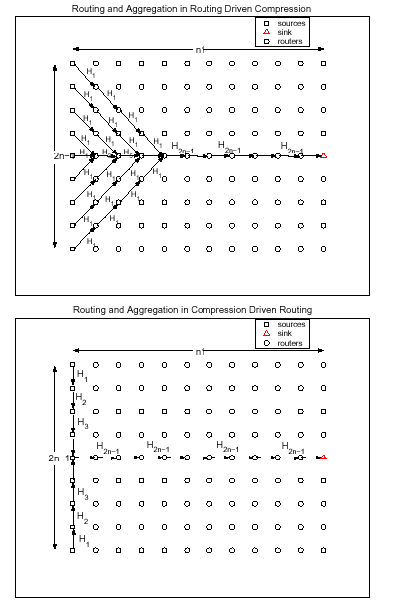
Basic Routing Strategies
Routing Driven Compression: route along shortest paths to sink, compress wherever paths happen to overlap
Compression Driven Routing: Route to maximize compression, though this may incur longer paths
Distributed Source Coding: perform distributed compression at sources, and route along shortest paths. If we ignore costs of learning correlation, this provides an idealized lower bound.

Slide 8
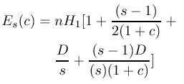

Cluster-based Routing + Compression
Consider a linear set of sources, in a 2D grid. Data from s nodes is compressed first before routing to the sink.
We can derive expressions for the energy cost as a function of the cluster size s:
We can even derive an expression for the optimal cluster size as a function of the network size and correlation level:

Slide 9
Low Latency Routing with Sleep
Lu, Sadagopan, Krishnamachari, Goel “Delay Efficient Sleep Scheduling in Wireless Sensor Networks,” IEEE Infocom 2005

Slide 10
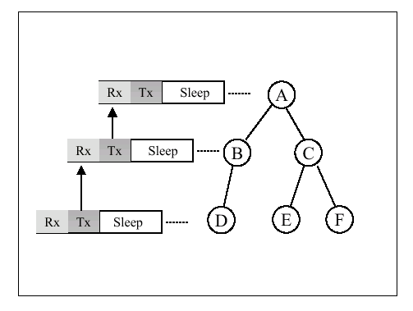
D-MAC: Basic Idea
Staggered sleep wake cycles minimize latency for one-way data gathering.

Slide 11
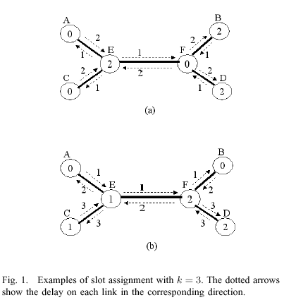
Problem Formulation
Given a graph G, assign one of k reception slots to each node to minimize the maximum (shortest-cost-path) delay between any two points in the network

Slide 12
D-MAC: Solution
The problem is NP-hard in general (3-SAT can be reduced to it)
Optimal solution may be obtained for some special cases (ring, tree and grid topology)

